Slide 1
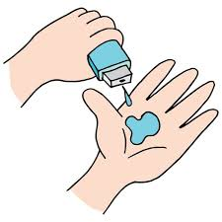
DOCTOR'S VISIT
STUDENT NAME :- VIRAJ VINOD BELE
AICT NO :- STU662ba6ddc52c41714136797
DEPARTMENT :- CSE(AI and Data Science)
SEM :- 5
YEAR :- 2024-25
COLLEGE NAME :- D.K.T.E. SOCIETY'S TEXTILE & ENGINEERING INSTITUTE
.

Slide 2

PROBLEM STATEMENT
Patients often face long wait times, limited communication, and difficulty understanding medical advice during doctor visits. These issues lead to frustration, decreased satisfaction, and potential misunderstandings about treatment plans. Improving the visit experience by enhancing communication, reducing wait times, and personalizing care can significantly boost patient satisfaction and health outcomes.

Slide 3
Project Description This project aims to improve the patient experience during doctor visits by streamlining communication, reducing wait times, and enhancing understanding of medical information. We will explore solutions like a digital scheduling system, real-time updates on wait times, and personalized educational materials to help patients better understand their treatment plans. By focusing on these aspects, the project seeks to enhance patient satisfaction, reduce stress, and support better health outcomes through a more efficient and informative visit process.

Slide 4

WHO ARE THE END USERS?
- Patients
- Doctors and Medical Staff
- Healthcare Administrators

Slide 5

Technology Used
- Electronic Health Records (EHR) Systems
- Patient Management Software
- Telemedicine Platforms
- Mobile Applications
- Data Analytics
- Automated Communication Tools
- Digital Health Education Platforms

Slide 6
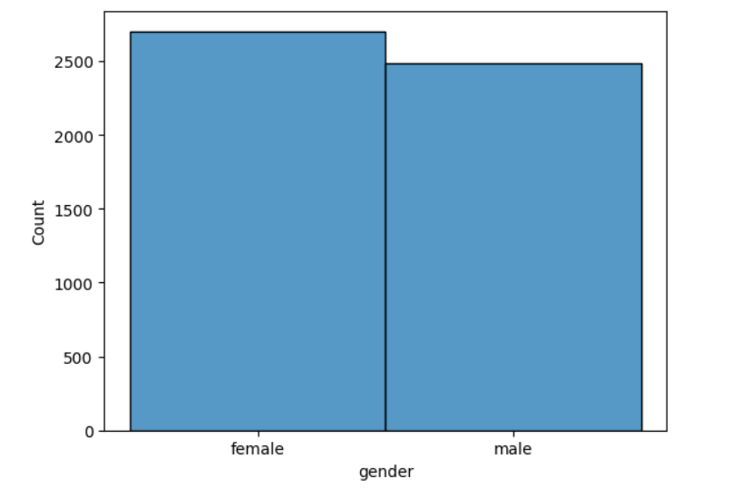
RESULTS
9. Count and Visualize the number of Males and Females affected by illness.
The provided bar chart visualizes the distribution of males and females affected by an illness. It shows that there are more females affected than males. The exact numbers can be read off the y-axis, which represents the count.

Slide 7
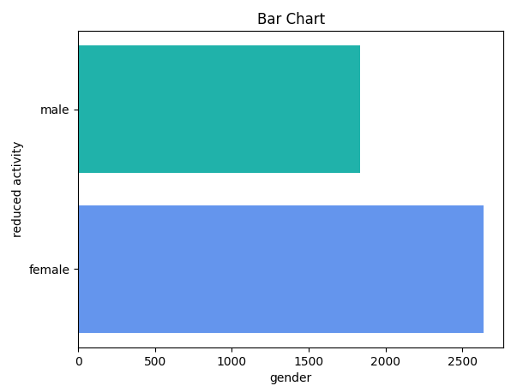
RESULTS
11.Plot a horizontal bar chat to analyze the reduced days of activity due to illness based on Gender
The provided bar chart visualizes the distribution of reduced activity days due to illness based on gender. It shows that females have a higher number of reduced activity days compared to males. The exact numbers can be read off the x-axis, which represents the reduced activity days.

Slide 8
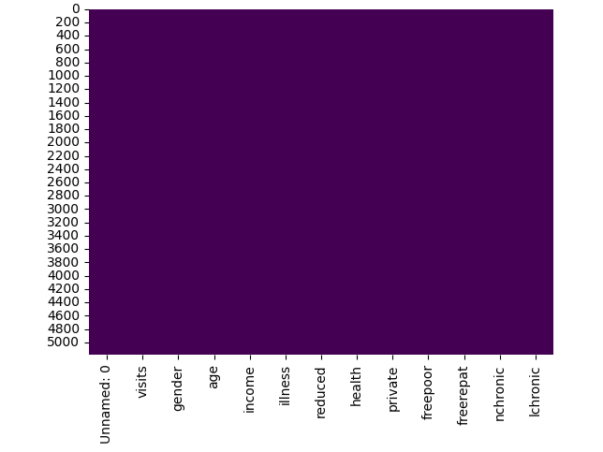
RESULTS
6.Visualize, is there is any missing values in the dataset based on a heat map
The heatmap shows the distribution of missing values in the dataset. The darker the color, the more missing values there are in that column. In this case, the heatmap is completely dark, indicating that there are no missing values in any of the columns.

Slide 9
THANK YOU!
.
.

